Slide 1

MOBILE USAGE AND NOMOPHOBIA
AAKASH SHEDGE 902
RANJEET JADHAV 905

Slide 2

CONTENT
Introduction
Objective
Methodology
Data and EDA
Statistical Analysis
Model Building
Conclusion

Slide 3
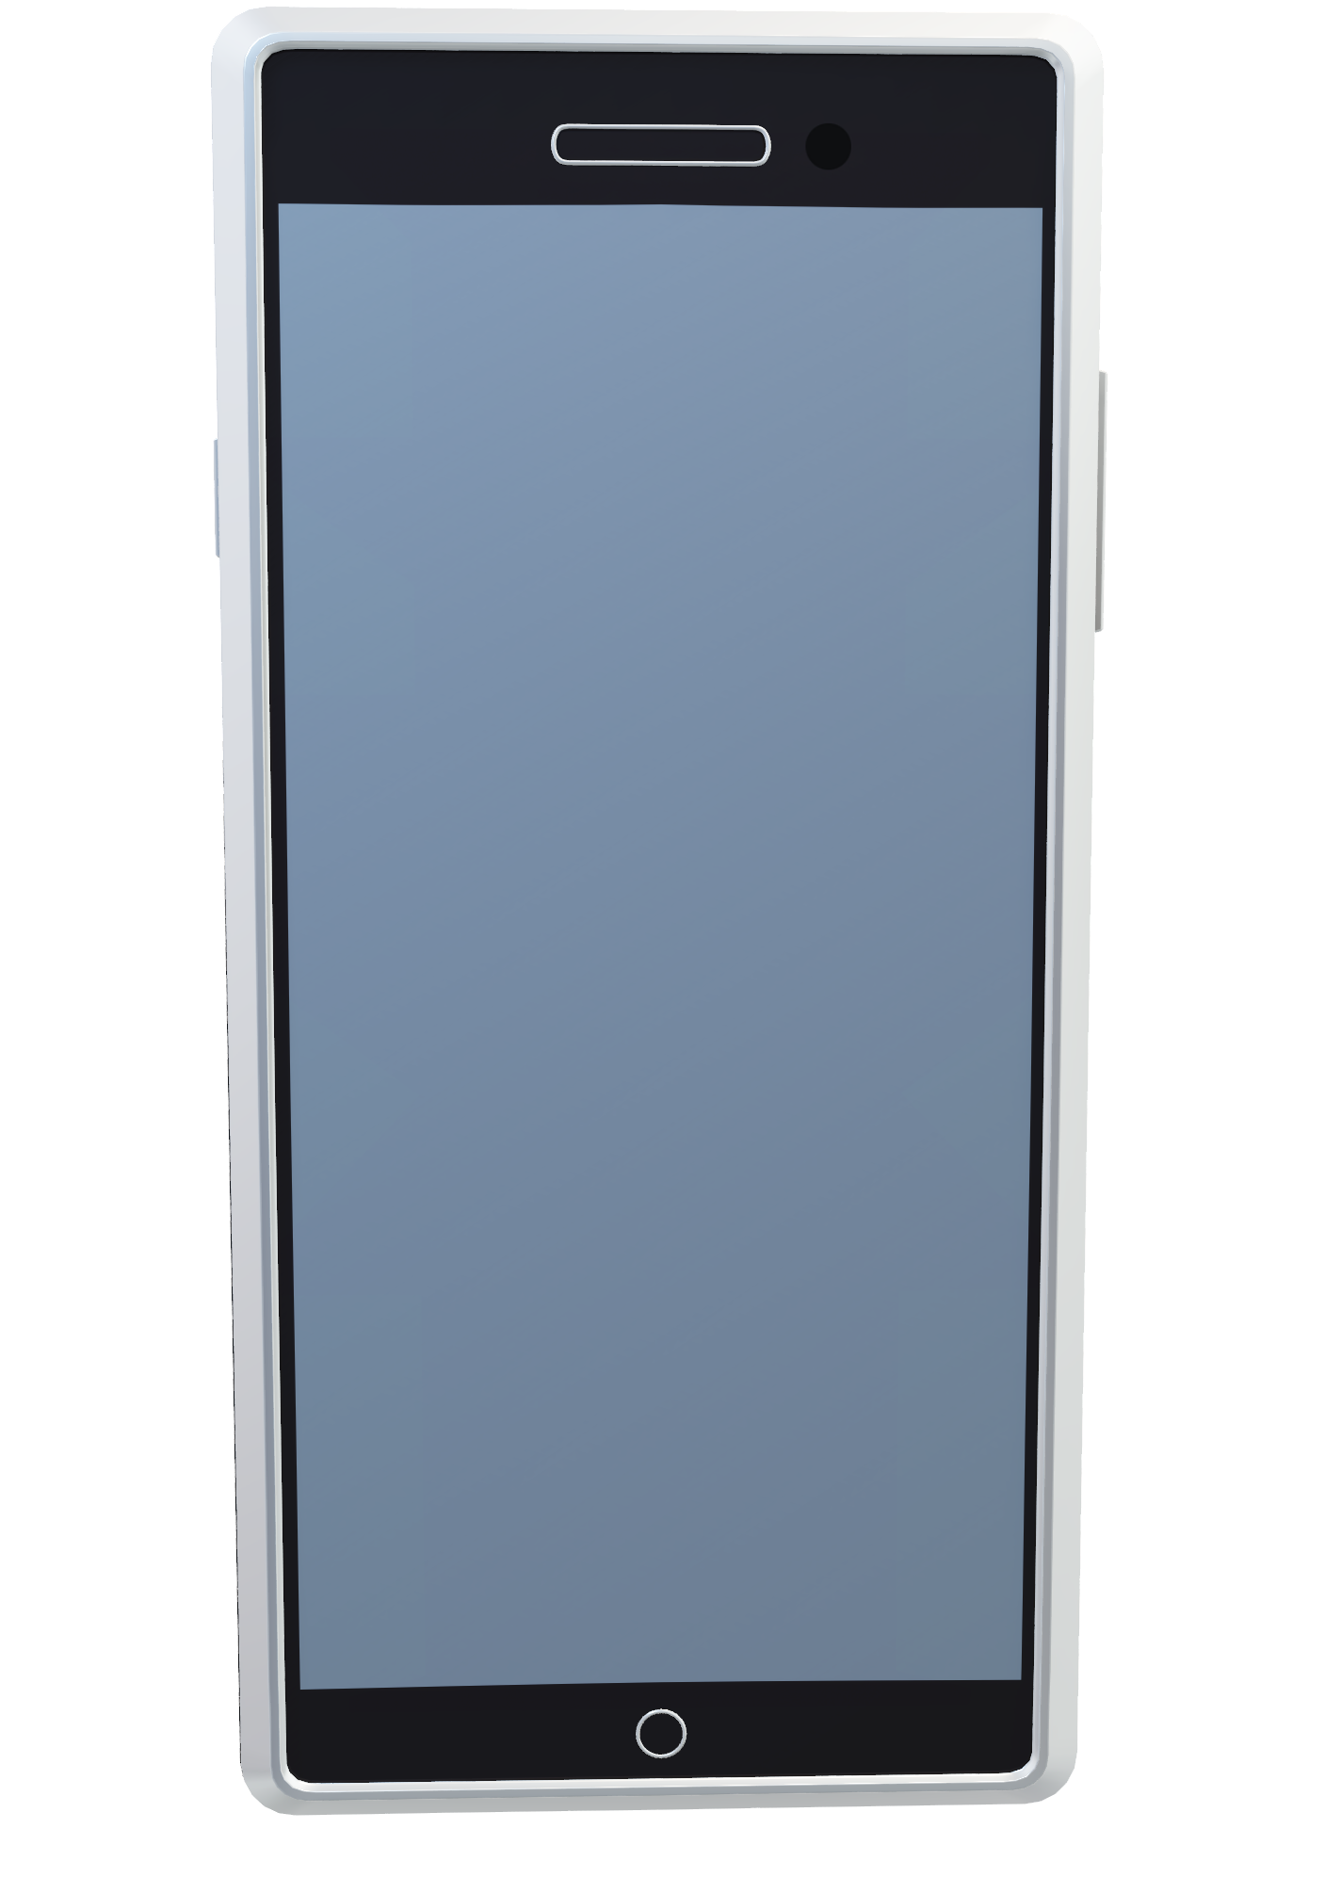
INTRODUCTION
In today's digital age, mobile devices have become an integral part of our daily lives, profoundly influencing various aspects of human behavior and social interactions.
This increased reliance on mobile devices has raised concerns about the potential negative impacts on individuals' well-being and mental health. One of the emerging phenomena associated with excessive smartphone usage is nomophobia, which refers to the fear of being without one's mobile phone.

Slide 4

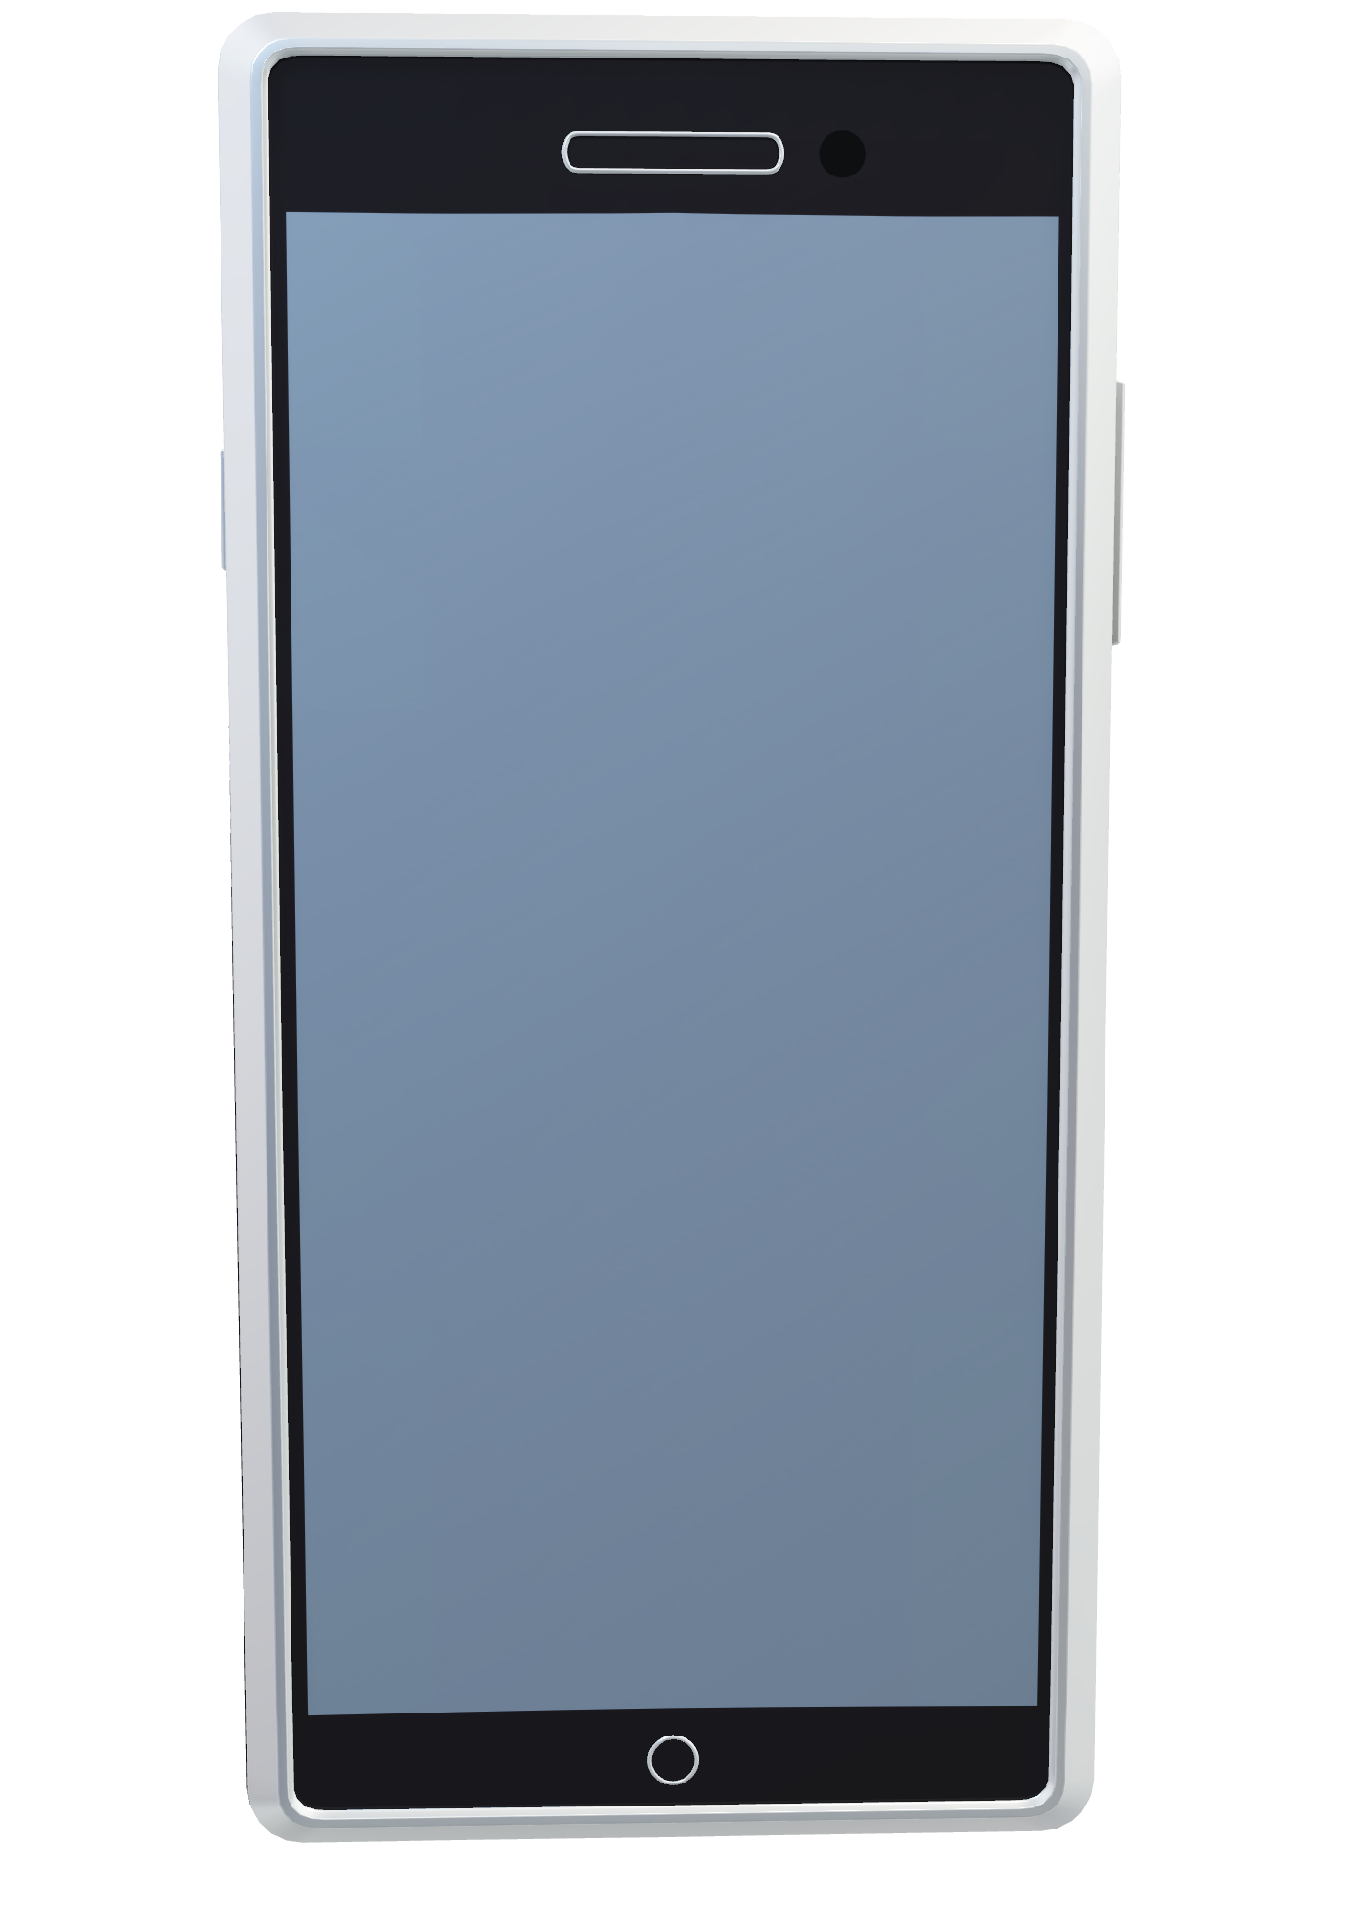
INTRODUCTION
In today's digital age, mobile devices have become an integral part of our daily lives, profoundly influencing various aspects of human behavior and social interactions.
This increased reliance on mobile devices has raised concerns about the potential negative impacts on individuals' well-being and mental health. One of the emerging phenomena associated with excessive smartphone usage is nomophobia, which refers to the fear of being without one's mobile phone.
Nomophobia is a growing concern in contemporary society, as people increasingly experience anxiety and discomfort when separated from their smartphones.

Slide 5
INTRODUCTION
In today's digital age, mobile devices have become an integral part of our daily lives, profoundly influencing various aspects of human behavior and social interactions.
This increased reliance on mobile devices has raised concerns about the potential negative impacts on individuals' well-being and mental health. One of the emerging phenomena associated with excessive smartphone usage is nomophobia, which refers to the fear of being without one's mobile phone.
The need for the Mobile Usage and Nomophobia study stems from the lack of comprehensive research on the prevalence and impact of nomophobia on individuals' lives.
This study aims to bridge the gap in knowledge by conducting a thorough investigation into mobile device usage patterns and the prevalence of nomophobia among individuals. By designing a well-structured questionnaire and collecting data from a diverse sample, this research seeks to gain insights into the frequency and duration of smartphone usage, the primary purposes for using mobile devices, and the psychological implications associated with nomophobia.
Nomophobia is a growing concern in contemporary society, as people increasingly experience anxiety and discomfort when separated from their smartphones.

Slide 6

Objectives

Slide 7
Objectives
To identify the factors that determine whether a person is Nomophobic or not.

Slide 8
Objectives
To identify the factors that determine whether a person is Nomophobic or not.
To identify associations and patterns of smartphone app usage.

Slide 9
Objectives
To identify the factors that determine whether a person is Nomophobic or not.
To identify associations and patterns of smartphone app usage.
To build a model that can predict whether a person is Nomophobic for not.

Slide 10

METHODOLOGY
Steps involved in conducting the study:
Defining our objectives and scope of the study
Data Cleaning and Pre-processing.
Statistical Analysis.
Model Building.

Slide 11
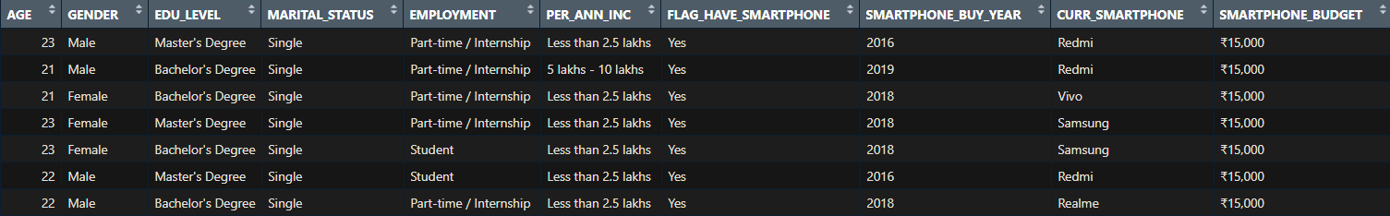
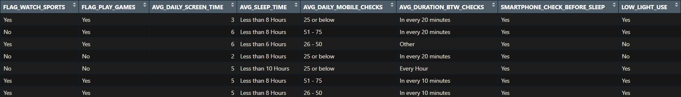
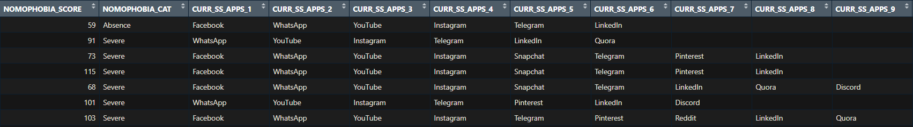
DATA SNAPSHOT

Slide 12
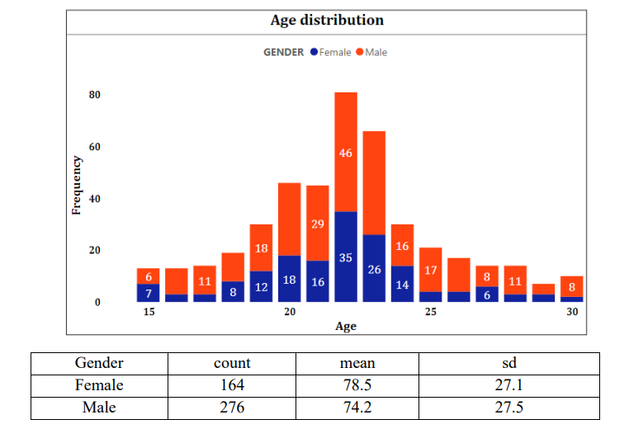
EDA : Visual Analysis
The bar graph represents the age distribution of the respondents, disaggregated by gender. The x-axis represents the age ranges, which range from 15 to 30 years old, and the y-axis represents the number of respondents in each age range.

Slide 13
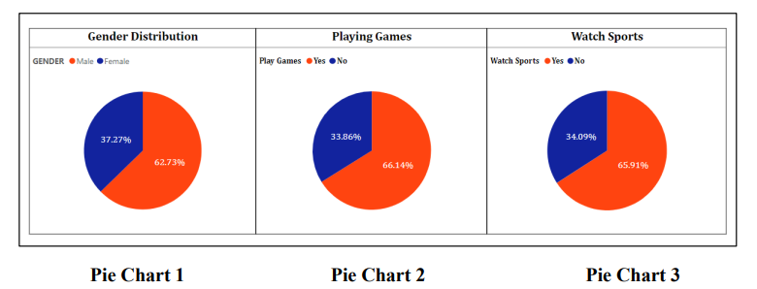
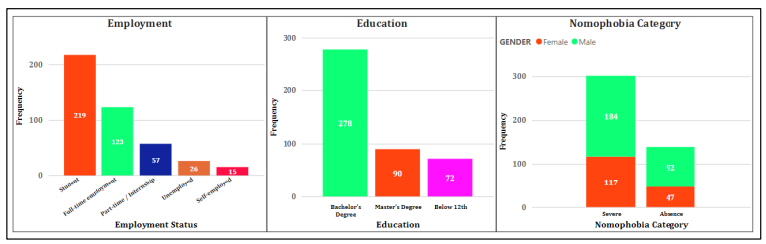

Slide 14
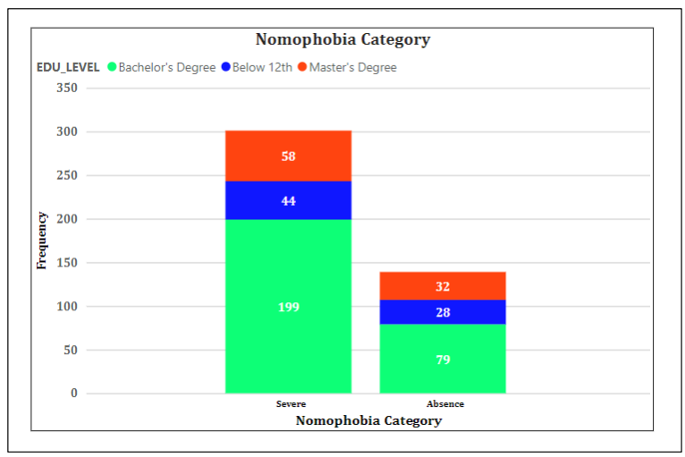
This is a stacked bar chart. In this case, the stacked bar chart represents the number of students who experience severe and no nomophobia in three different education levels: Bachelor's, Below 12, and Master's.

Slide 15
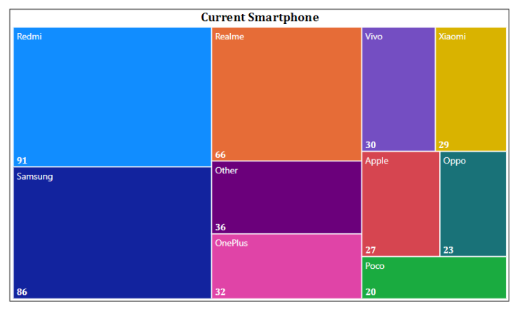
In the context of the given example, the treemap is used to represent the distribution of different types of mobile devices being used by individuals. Each rectangle in the treemap represents a different type of device, with the area of the rectangle proportional to the number of individuals using that device.

Slide 16
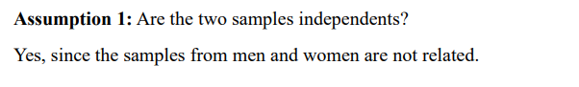
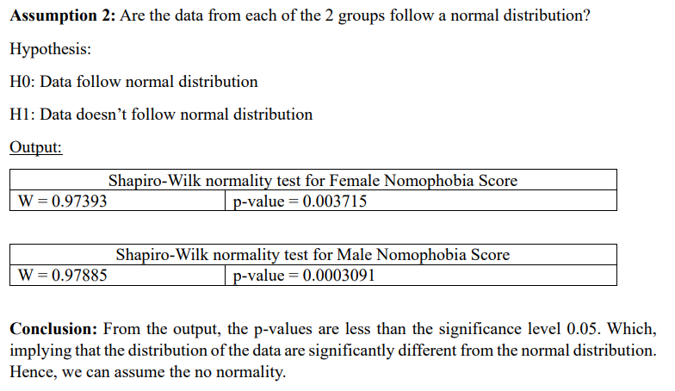
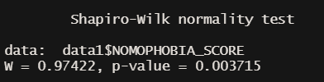
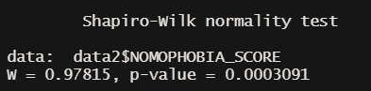
t test
Gender
Hypothesis:
H0: There is no significant difference in the mean Nomophobia score in Female and Male.
H1: There is significant difference in the mean Nomophobia score in Female and Male.

Slide 17
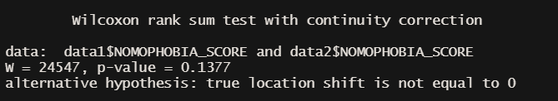
Wilcoxon Sign Rank Test
Assumptions:
Data are paired and come from the same population.
Each pair is chosen randomly and independently.
The data are measured on at least an interval scale when, as is usual, within-pair differences are calculated to perform the test (though it does suffice that within-pair comparisons are on an ordinal scale).
Hypothesis:
H0: There is no significant difference in the median Nomophobia score in Female and Male. (Mx=MY)
H1: There is significant difference in the median Nomophobia score in Female and Male. (Mx≠MY)
Output:
Conclusion: The p-value of the test is 0.1377, which is greater than the significance level alpha = 0.05. We can conclude that Female median Nomophobia score is not significantly different from Male’s median Nomophobia score with a p-value = 0.1377.

Slide 18
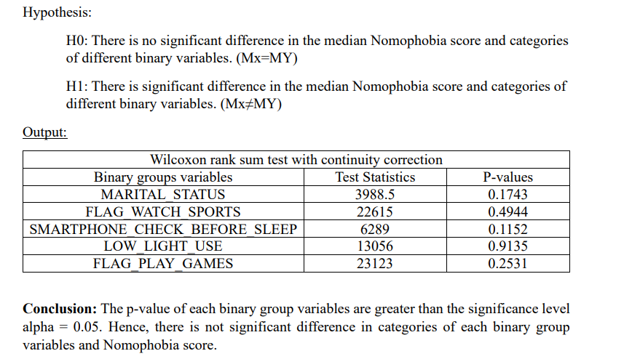
Similarly for other binary groups

Slide 19
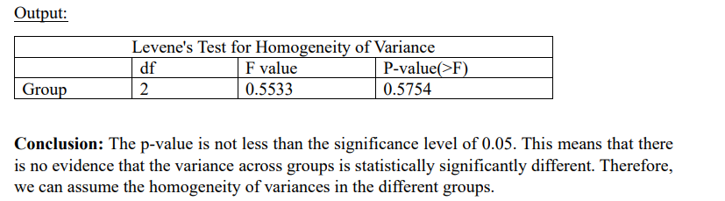
One Way ANOVA
Assumptions:
The one-way ANOVA has several assumptions that need to be met for the results to be reliable. The main assumptions are:
The variances of the dependent variable are equal across the groups.
The dependent variable is continuous and normally distributed in each group.
The observations are independent within and between groups.
Education Level
Hypothesis:
H0: The means of all groups are equal.
H1: At least one of the means of the groups is different from the others.
Preliminary test to check one way ANOVA assumptions:
The ANOVA test assumes that, the data are normally distributed and the variance across groups are homogeneous.
Assumption 1: The variances of the dependent variable are equal across the groups.

Slide 20
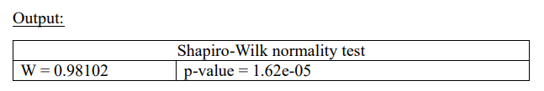
Assumption 2: Are the data from each of the 2 groups follow a normal distribution?
Hypothesis:
H0: Data follow normal distribution
H1: Data doesn’t follow normal distribution
Conclusion:
The p-value obtained from the Shapiro-Wilk test to check the normality of the data is 1.62e05, which is less than the significance level of 0.05. This indicates strong evidence against the null hypothesis of normality, suggesting that the data is not normally distributed. Therefore, the assumption of normality for the data is violated, and any statistical tests that require normality assumption may not be appropriate to use. In such a case, non-parametric tests such as Kruskal-Wallis test, or Friedman test could be used as alternatives to the parametric tests.

Slide 21
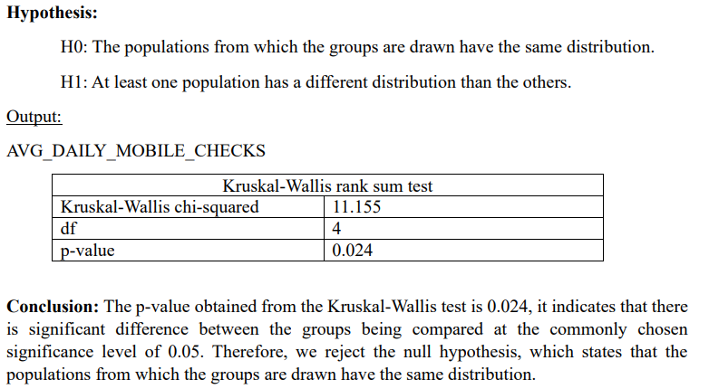
Kruskal-Wallis test
Assumptions:
Independent samples: The groups being compared are independent of each other.
Random samples: The data is sampled randomly from the population.
The dependent variable is measured on an ordinal or continuous scale.
The shape of the distributions of the groups being compared is not assumed to be normal.
Homogeneity of variance: The variance of the dependent variable is equal across groups.

Slide 22
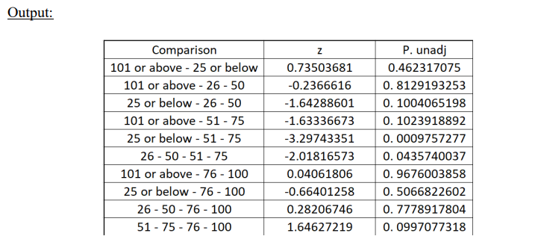
Dunn Test
The Dunn test, also known as the Dunn's post hoc test or Dunn's multiple comparison test, is a non-parametric statistical test used to perform pairwise comparisons between multiple groups after conducting a Kruskal-Wallis test or a one-way analysis of variance (ANOVA) on ranked data. It is specifically designed to identify which groups are significantly different from each other.
The hypothesis for the Dunn test can be stated as follows:
Null Hypothesis (H₀): There is no significant difference between the two groups being compared.
Alternative Hypothesis (H₁): There is a significant difference between the two groups being compared.

Slide 23
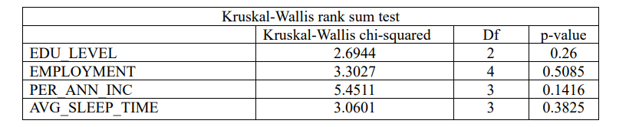
Similarly, for other variables which contain more than two categories.
The hypothesis of the Kruskal-Wallis test is that Hypothesis:
H0: The populations from which the groups are drawn have the same distribution.
H1: At least one population has a different distribution than the others.
Conclusion:
The p-value obtained from the Kruskal-Wallis test are greater than level of significance for EDU_LEVEL, EMPLOYMENT, PER_ANN_INC, & AVG_SLEEP_TIME, it indicates that there is no significant difference between the groups being compared at the commonly chosen significance level of 0.05. Therefore, we fail to reject the null hypothesis, which states that the populations from which the groups are drawn have the same
distribution. For AVG_DAILY_MOBILE_CHECKS we can assume that there is a significant difference among the groups and more specifically between ’25 or below’ and ’51 – 75’ category using Dunn Test.

Slide 24



Model Building
In this section, we constructed a range of models to analyze the dataset and address various objectives. Each model was built with a specific purpose in mind, leveraging different techniques and algorithms to gain insights and make predictions. The following models were develop.

Slide 25
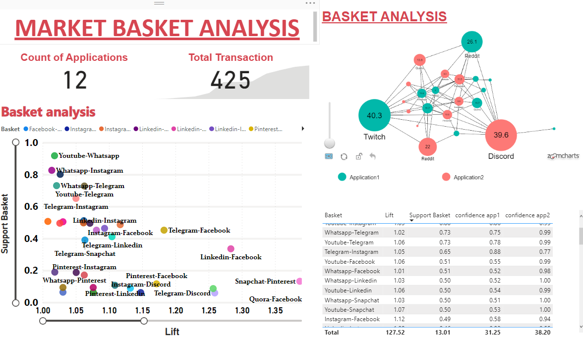
Market Basket Analysis - Advanced EDA
The table includes associations involving multiple platforms, such as LinkedIn, Instagram, Snapchat, Facebook, Pinterest, YouTube, Quora, and
Telegram. These associations demonstrate the relationships between these platforms
and indicate the likelihood of customers using multiple platforms together.

Slide 26
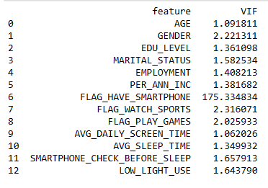
Linear and logistic regression
Normality ,homoscedasticity , autocorrelation, linearity this assumption are satisfied for linear and logistics regression except multicollinearity present in the data.
Multicollinearity refers to a situation where two or more predictor variables in
a regression model are highly correlated with each other.
This violates the assumption of independence among predictor variables and can lead to unreliable coefficient estimates and unstable model performance.

Slide 27
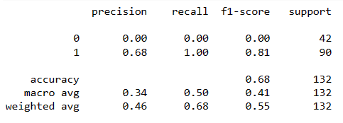
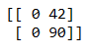
Support Vector Machine (SVM)
Confusion Matrix
Classification report
AUC score : 0.5 Model Moderate performance
Accuracy : 0.68
68% Test data where classify correctly
F1 – Score
0 for Absent
0.81 for present
Imbalance of the data introduce instability in the model.

Slide 28
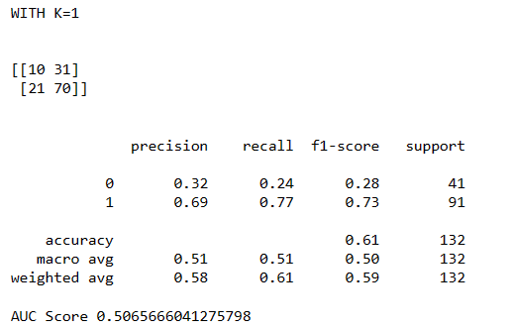
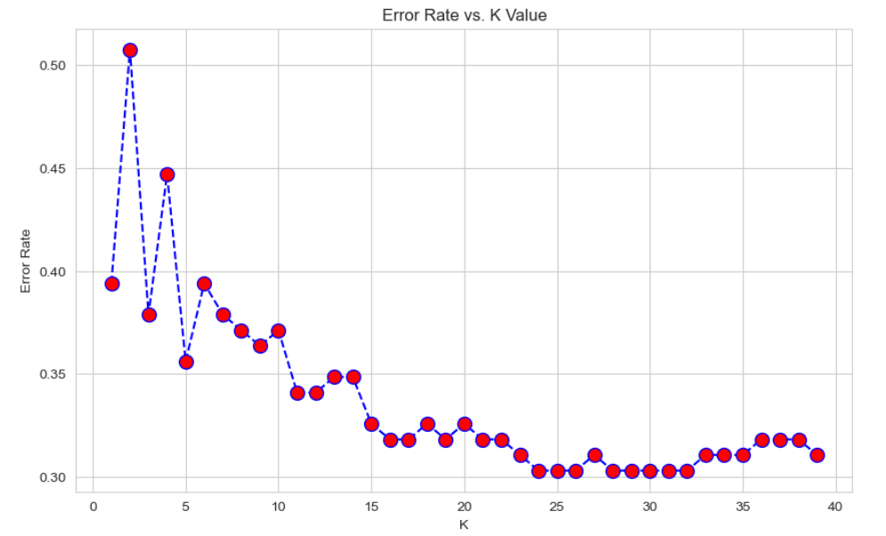
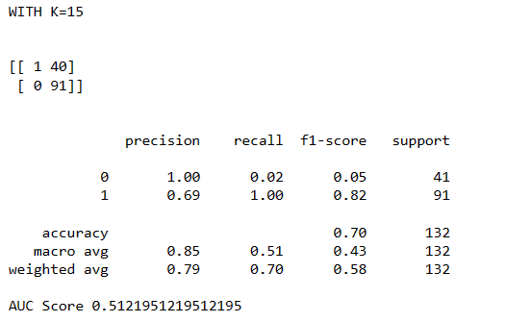
k-nearest neighbour's algorithm (KNN)
KNN determines the class of data point by majority voting principle. It is non- parametric ML algorithms.
We use the above graph for how many K-values we get for classification.

Slide 29
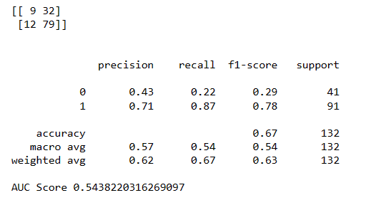
XGBoost Algorithm
Provide accurate results and a highly –scalable training method that avoids overfitting
It is boosting algorithm so its very sensitive to outliers.
It can sometimes struggle with imbalance dataset.

Slide 30
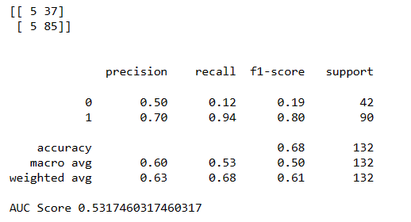
Ridge Classifier Algorithm
ridge classification is a technique used to analyze linear discriminant models
Converts the target variable into +1 and -1 appropriately
Train a Ridge model with loss function as mean square loss with L2 regularization (ridge) as penalty term
During prediction, if the predicted value is less than 0, it predicted class label is -1 otherwise the predicted class label is +1.

Slide 31
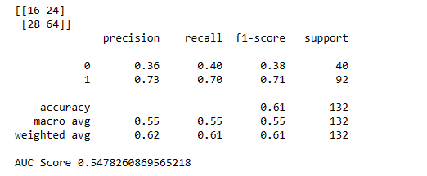
Decision Tree
A decision tree is a non-parametric supervised learning algorithm, which is utilized for both classification and regression
a decision tree generally needs overfitting of data. In the overfitting problem, there is a very high variance in output which leads to many errors in the final estimation and can show highly inaccuracy in the output.
Here , we can see on classification report.
The AUC Score is 0.54. basically if AUC score is smaller then 0.5 model is not perform well.
Accuracy of the model is also getting low.

Slide 32
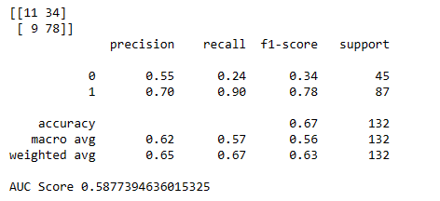
Random Forest Algorithm
Random forest is a commonly-used machine learning algorithm which combines the output of multiple decision trees to reach a single result.
Random Forest grows multiple decision trees which are merged together for a more accurate prediction.
Random Forest reduces overfitting and s less sensitive to noise and outliers in the data.
Here, AUC score is 0.58 means moderate performance of the model. precision and recall gives better results then other classification problem
On the classification report we conclude that Random forest given the best results then other classification algorithms

Slide 33
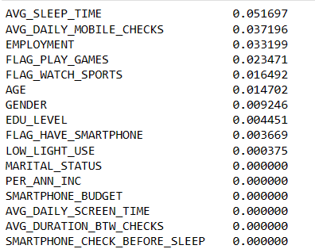
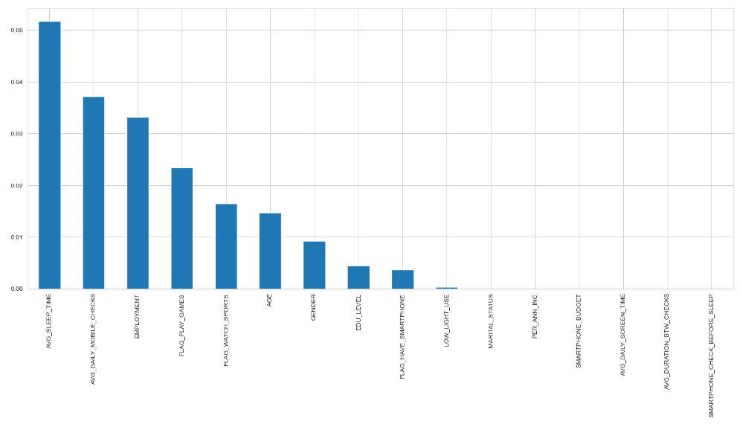
Feature Selection for Random Forest
We doing this selection method for gives more accurate and better classification results. For that we use mutual information gain technique.
In short :- A quantity called mutual information measures the amount of information one can obtain from one random variable given another.
Mutual Information

Slide 34
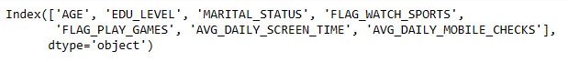
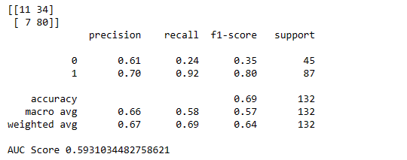
After Feature selection its give a better report.
AUC score is getting increases by 1%.
Precision is also perform well in this model.
Recall for present is getting increases by 2%. Where 24% of actual ‘Absent’ instances are correctly identified.
For ‘Present’ 92% of instances are correctly identified.
F1 score 64% which takes into account the class imbalance.
Accuracy is 69% of the instances in the test dataset were classified correctly.
Model performs well in terms of class separation.
This 6 features are selected. On this we perform random forest algorithms

Slide 35




Thank you

